Slide 1
Seeing Outside in:
Mapping your external attack surface
Arcadio “Aggie” Aguilar

Slide 2
agenda
Setting the stage
baselining your perimeter
use Case #1
Use Case #2
Resources
1. Gain visibility into your perimeter
2. Are we vulnerable to <latest badness>?
Notes:
Setting the stage – what we have to start with – nothing
This is a difficult problem.

Slide 3
About me
Retired usaf intel analyst
Senior Threat Analyst
Crazy dog dad
Notes:
I love my doggo!!

Slide 4
So what?
2023 ransomware attacks increase more than 95% over 2022
Ransomware earned criminals $1 billion in 2023
Nov ‘23 ○ Citrix bleed 450+ ○ easily bypassed multi-factor authentication
Jan ‘24 ○ Ivanti pulse connect ~22k devices ○ mass exploitation within days
Are we vulnerable to <latest badness>?
Notes:
Why should the audience care – not trying to be a scare tactic slide but reality is what it is
Sources for these stats are at the end of the presentation

Slide 5
scenario
solo or small team (2 people)
No one has a list of ips that you own
No one knows domain names that you own
No one responds to your teams messages
No problem
Know where to start ○ overcome paralysis
Baselining your attack surface at almost no cost (one time - $50)
Reduce risk for your company ○ show immediate value
Get it fully completed will take time!!
Notes:
Setting the stage – what we have to start with – nothing
This is a large difficult problem.

Slide 6
Where to start?
Does your Company have a website?
www.bestbuy.com
Run root domain through dnsdumpter ○ export results
Search organization* in shodan ○ export results
Use censys tactically on assets you want more information on
* Does not have to be organization, there are a lot of possibilities
Notes:
For this presentation I am using Best Buy as an example.
This is the high-level workflow in words – next slide has the same things but in a visual form.
Lingered too long on this slide – be concise and move on. Tighten up wording.

Slide 7
Example Baseline Workflow
Dnsdumpster
Start here
Enumerate subdomains
Export results
Discover new pivot points
Validate findings
censys
shodan
Discover new pivot points
Validate findings
Export results
Notes:
Sample workflow visual diagram. This is only a sample, it worked well for us but other teams might find something that works better,
You don’t want to take one source has gospel, you always want to verify/validate every piece of information. Cross-INT – trust but verify.

Slide 8
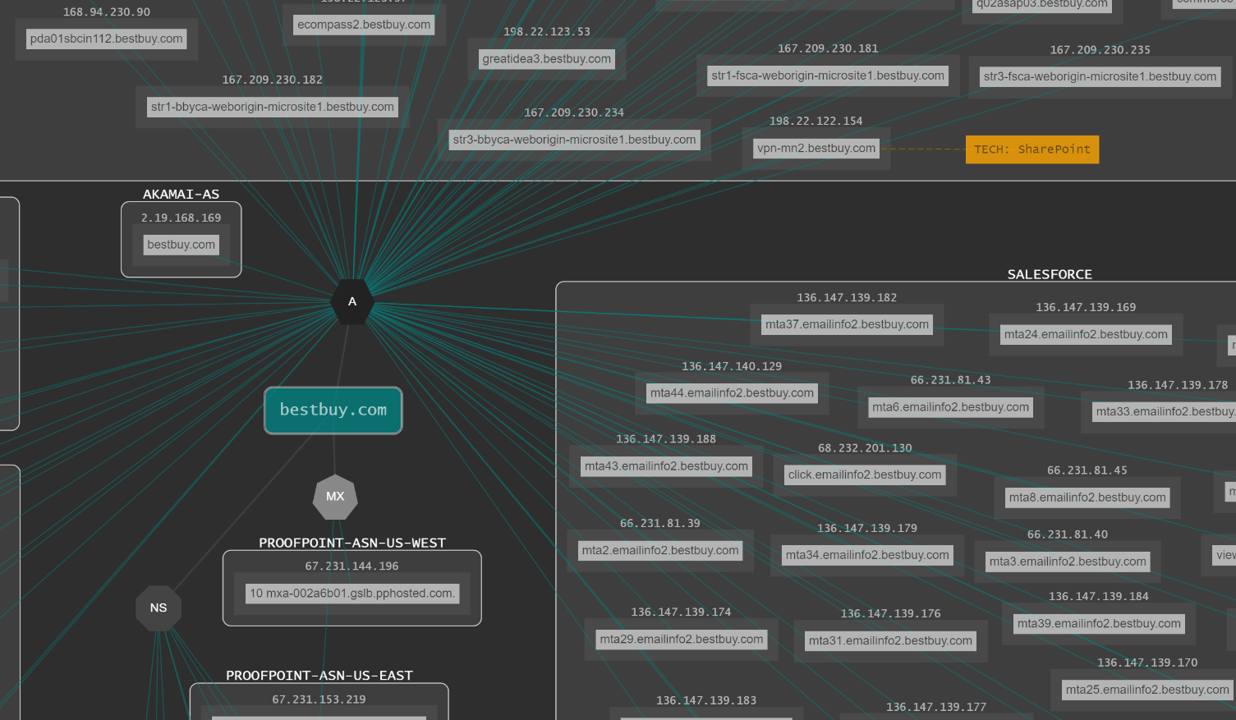
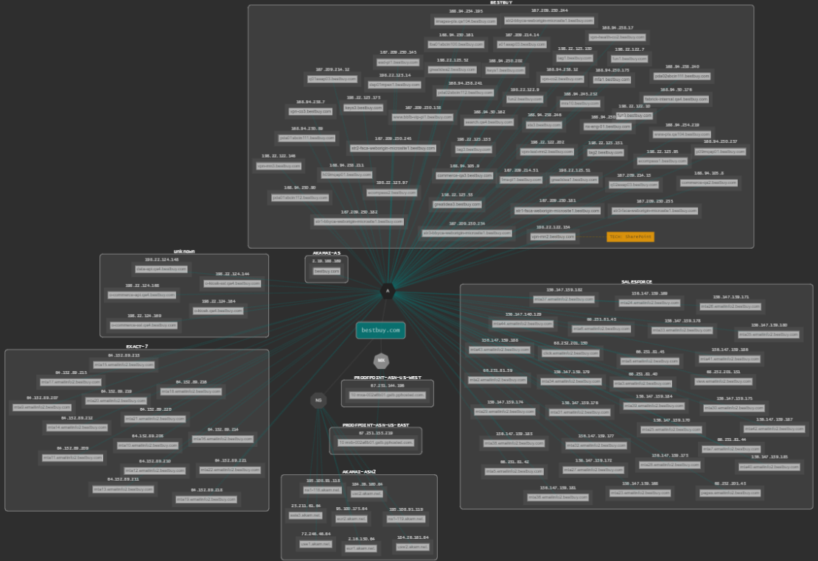
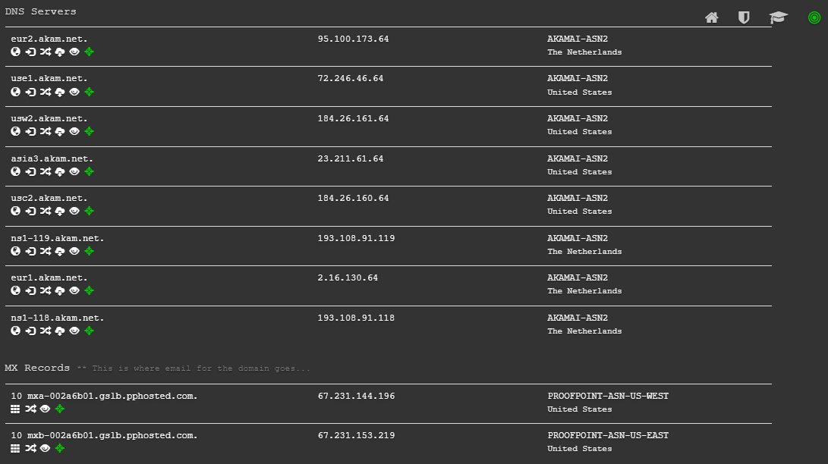
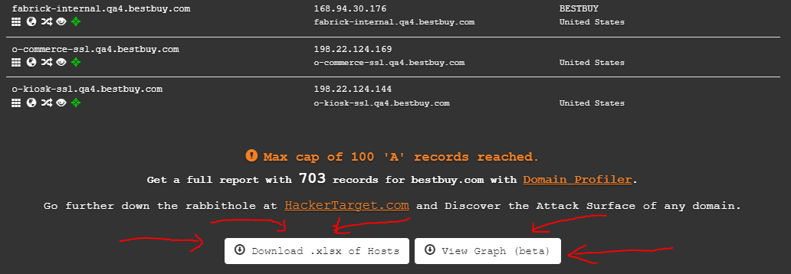
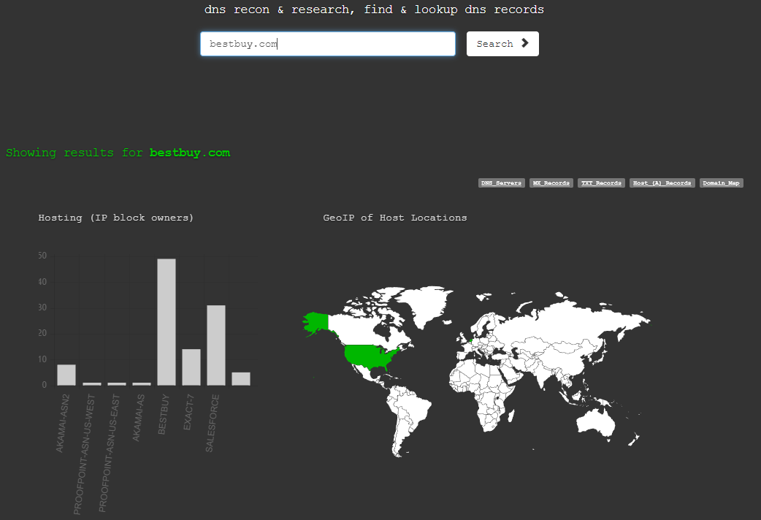
dnsdumpster
bestbuy.com
100 Host records
8 name servers
7 Hosting Providers
2 mail servers
1 ext network map
1 spreadsheet
Notes:
Walking through how to use dnsdumpster to enumerate your stating domain.
I use a ‘ticker’ style in the upper-right to give the audience of just how much information you can get with one search.
Instead of looking at hitting the 100 record max as an obstacle use it as an opportunity – let your management know that with no budget you are limited in your collection – start building your business case.

Slide 9
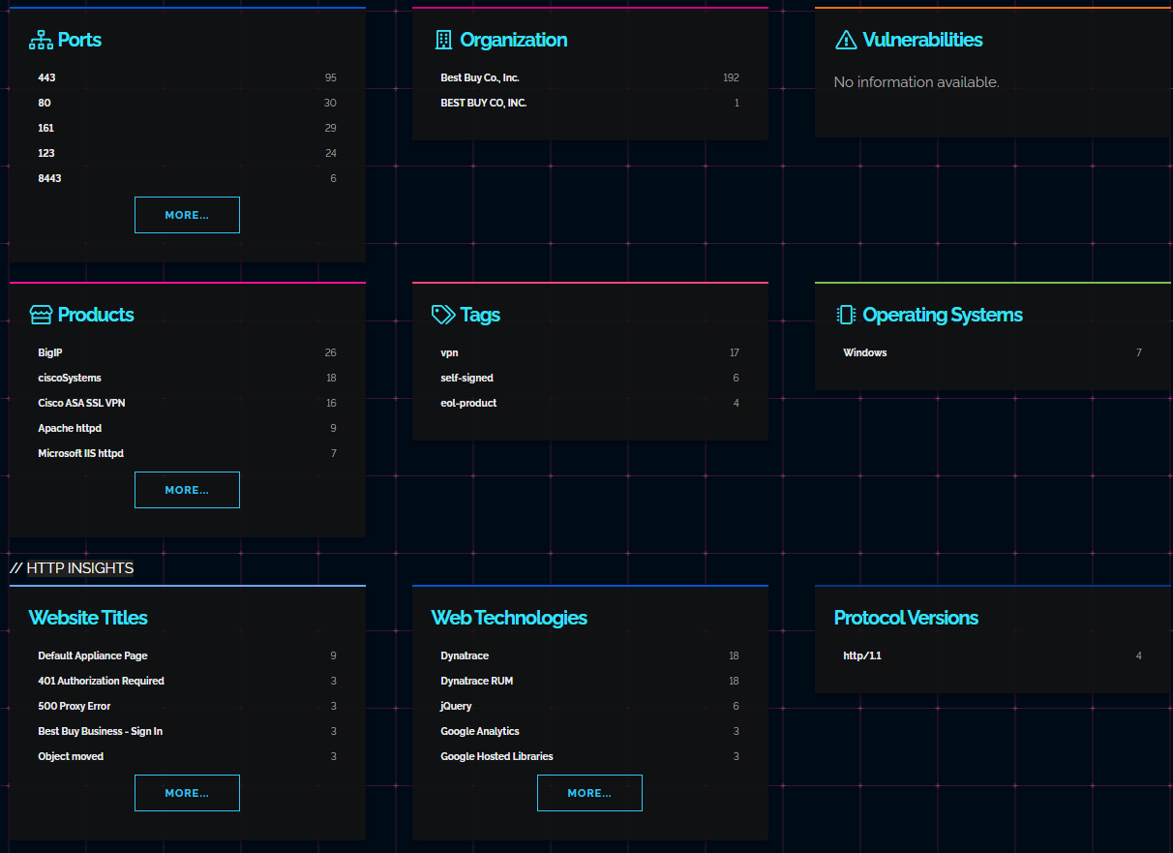
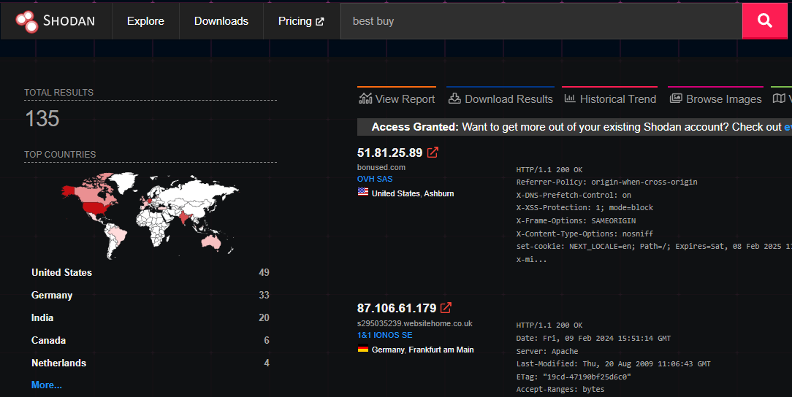
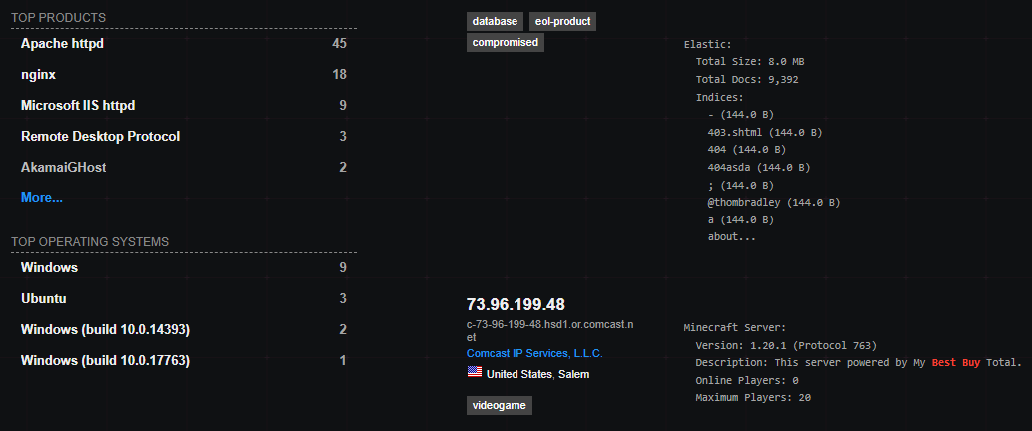
shodan
Best buy
14 domains
Cast wide net ○ investigate ○ validate ○ enumerate
12 web technologies
10 open ports
10 Products
Notes:
*FEEDBACK – story too long -> keep it high level and shorten it. No need to go over every piece.
Walking through how to use Shodan to validate current findings and finding new pivot points.
Upper-right ticker again to show what information can be gathered.
https://securitytrails.com/blog/jarm-fingerprinting-tool - JARM explanation

Slide 10
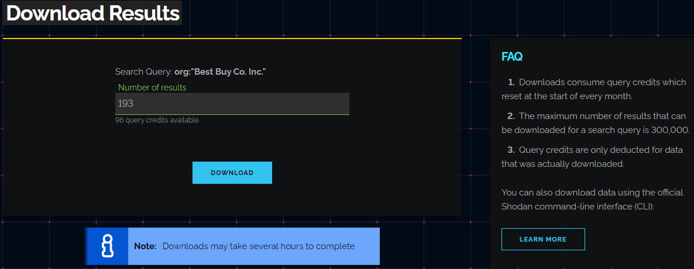
shodan
Download results only in json.gz format
Shodan and a command line interface (CLI)
Use “shodan convert” to convert json.gz to xlsx
shodan convert nginx-sample.json.gz xlsx
Notes:
Download results – does not come in xlsx form –use CLI to convert it and add to dnsdumpster report.

Slide 11
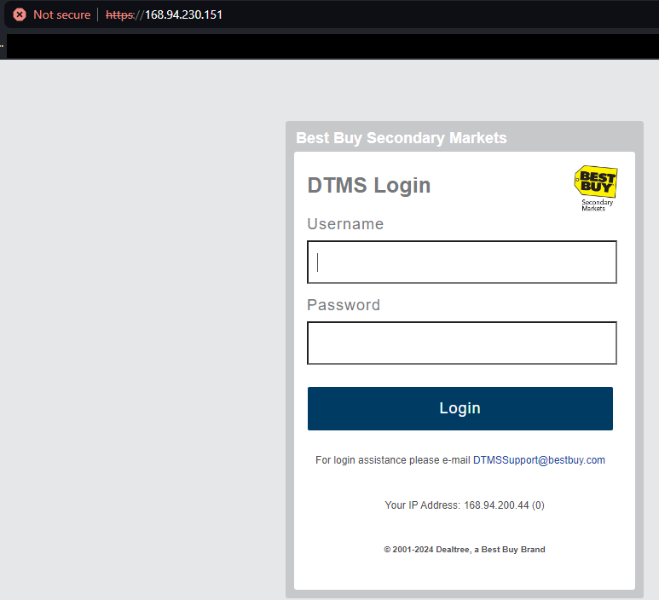
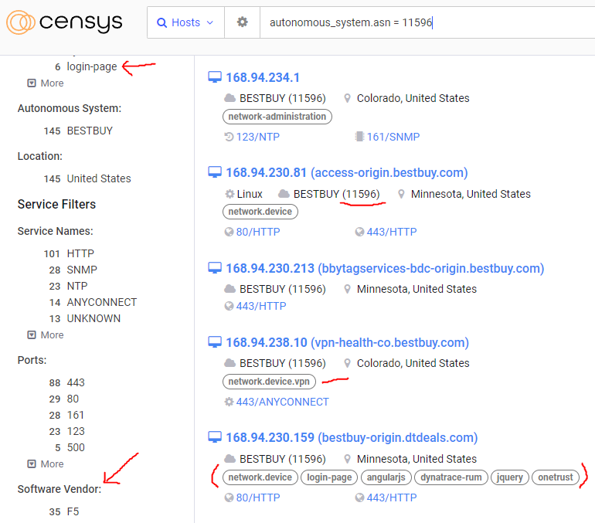
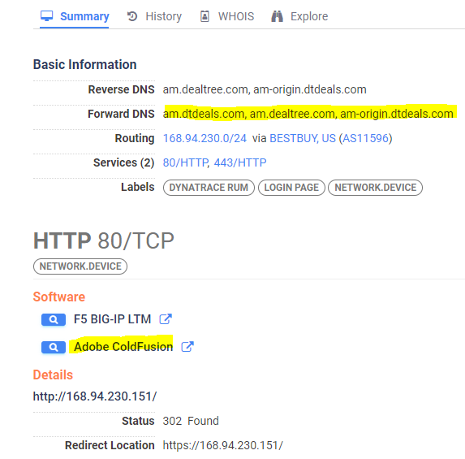
Censys
Use info from dnsdumpster & shodan
Enrich & validate findings
Do login pages have mfa enabled?
Notes:
What is an AS number?
- Validate login pages
- Keep list of software vendors
- Pay attention to technologies and tags per asset

Slide 12
Recap so far
Started with nothing
8 hosting providers ○ 8 nameservers ○ 2 mail servers
15 domains ○ 167 subdomains (bestbuy, geeksquad, dtdeals)
20 Autonomous system numbers
20 ports ○ 23 products/vendors ○ 20 service names
4 spreadsheets (bestbuy, geeksquad, dtdeals + shodan)
1 external network map
Investigate ○ validate ○ enumerate ○ pivot
This take a lot of time!
Notes:
Recap everything we have learned – I only added information for 3 domains listed on the page.

Slide 13
Now what?
We have a good baseline and talking with other offices on findings
Work on automation to keep baseline up to date
Add vendors, products, technologies to rss reader to get real-time alerts
Can use google alerts to get notifications
Still need to answer the dreaded question:
Are we vulnerable to <latest badness>?
Notes:
We still haven’t answered the dreaded question – Are we vulnerable ?
Walk through two use cases.
Citrix
Ivanti pulse secure
Set up transition between what we just did with the use cases.

Slide 14
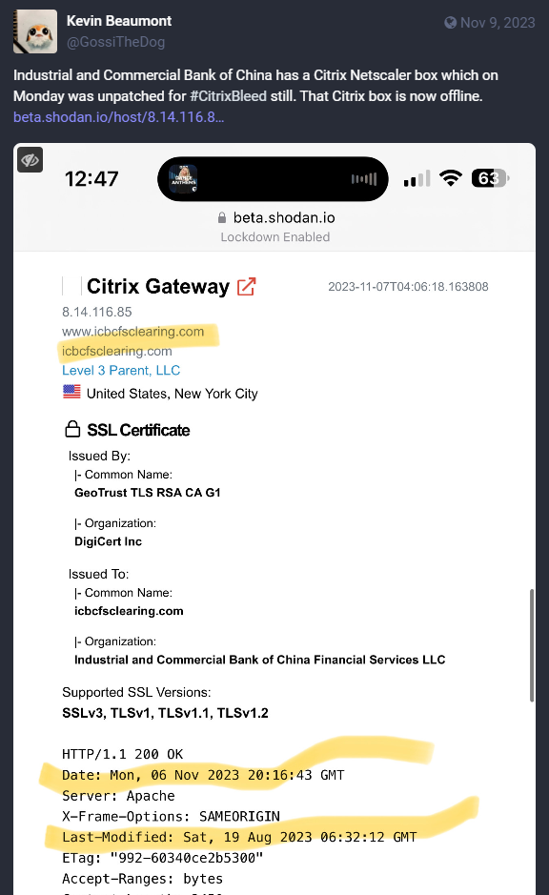
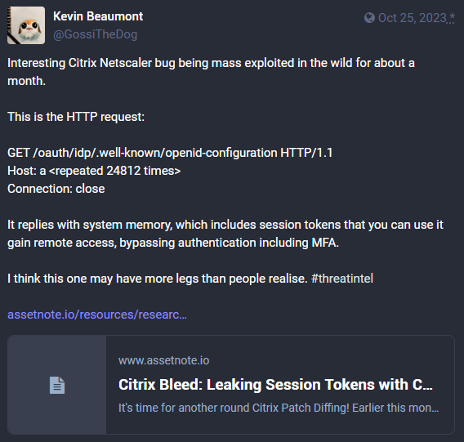
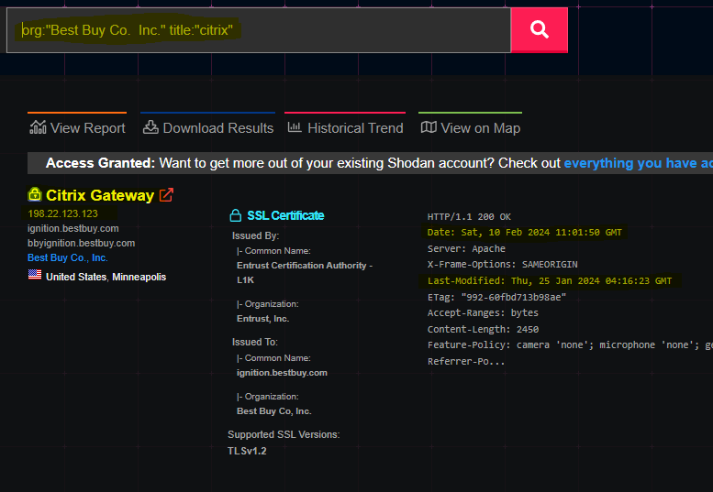
Badness #1 – Citrix bleed
CVE-2023-4966
Check baseline
Check vendor alerts
Check other collection sources
Notes:
Check baseline to see if you have citrix and/or netscaler anywhere on your spreadsheet
Check if you have received any vendors alerts or advisories
Check other collection sources – social media is GREAT!
- Not only do you find great security researchers that provide actionable information in their posts – but they link to other sources as well. When you find these collection sources add them to your daily checks!!
Timeline
Oct 12 – first reporting seen. Webshell backdoor
Oct 25 – mass exploitation
Oct 26 – github scanner to use to see if your vulnerable. Kill sessions AFTER patching
Oct 28 – 20k Netscalers vuln. Video on how easy exploit is
Oct 31 – hunting artifacts revealed
Nov 1 – Mandiant report
Nov 9 – One of many screenshots verifying that this company is vulnerable – we can run this query on OUR organization to see if we are vulnerable!!
Shodan query showing that YES Best Buy has a Citrix appliance and it was last modified Thurs Jan 25 2024.

Slide 15
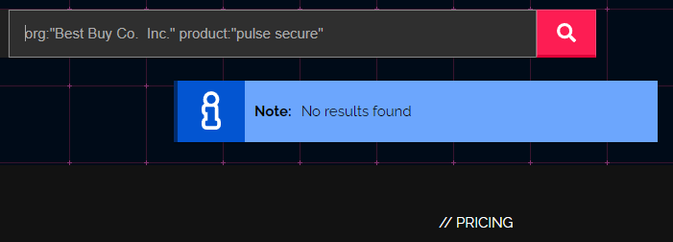
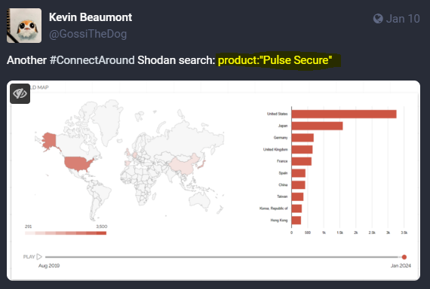
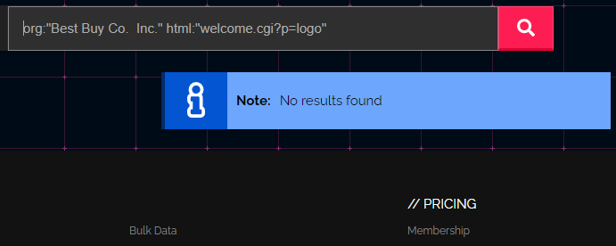
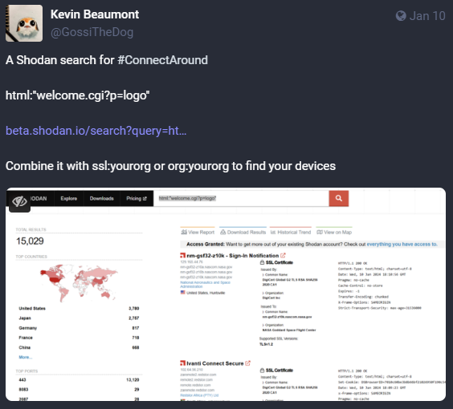
Badness #2 – Pulse Connect
CVE-2023-46805 & CVE-2024-21887
Check baseline
Check vendor alerts
Check other collection sources
Notes:
Badness #2 – Pulse Connect
This one is much shorter.
Jan 10 – Reporting on Ivanti zero-days start ramping up. Shodan search query to see Ivanti devices + your org to see if you use them.
Jan 10 – Another Shodan search query
Let’s see if Best Buy has these products!

Slide 16
Sources
https://www.darkreading.com/cyberattacks-data-breaches/2023-ransomware-attacks-up-more-than-95-over-2022-according-to-corvus-insurance-q3-report
https://www.thestack.technology/ransomware-1-billion-payments-2023/
https://www.globalsecuritymag.fr/ransomware-and-cyber-extortion-trends-in-q4-2023-reliaquest-threat-research.html
https://www.redpacketsecurity.com/ransomware-re
https://dataconomy.com/2024/02/07/cve-2024-21893-ivanti-vulnerability-2024/view-december-2023-7/
https://attackerkb.com/topics/FGlK1TVnB2/cve-2024-21893/rapid7-analysis
https://therecord.media/ivanti-vulnerabilities-cisa-emergency-directive

Slide 17
tools
Dnsdumpster - https://dnsdumpster.com/
https://dnsdumpster.com/footprinting-reconnaissance/
Shodan - https://shodan.io/
https://www.shodan.io/search/examples
https://www.sans.org/blog/getting-the-most-out-of-shodan-searches/
Censys - https://censys.com/
https://search.censys.io/search/getting-started
https://support.censys.io/hc/en-us/categories/4405770552724-Censys-Search
ProjectDiscovery – Subfinder - https://github.com/projectdiscovery/subfinder

Slide 18
tools
Inoreader - https://www.inoreader.com/
https://www.inoreader.com/blog/category/how-to
FeedlyShodan - https://feedly.com/
https://docs.feedly.com/
Google Alerts - https://www.google.com/alerts
Zapier – https://zapier.com/
N8n - https://n8n.io/

Slide 19
social media
Kevin Beaumont - Mastodon @GossiTheDog@cyberplace.social
Simon - Mastodon @simontsui@infosec.exchange
Shodan – Mastodon @shodan@mastodon.shodan.io
Ransomlook – mastodon @ransomlook@social.circl.lu

Slide 20
Questions?
aggie.bsides@gmail.com

