Slide 1
Nation-State Threats in the Open-Source Software Supply Chain
Ross Bryant, Ph.D.
Chief of Research
phylum.io
Notes:
My name is Ross Bryant and I am the Chief of Research at Phylum.
Today I want to talk to you about the proliferation of threats from Nation–State actors in open-source software ecosystems
Phylum is an open-source software supply chain security company, and

Slide 2
Who We Are
Notes:
If you aren’t familiar with us, here's a brief introduction

Slide 3
Who We Are
Series A startup
Founded in March 2020
100% remote
Italy to California
Monitor open-source software ecosystems for risk
Notes:
Phylum is a Series A startup that just turned 4 this past March.
About a third of our company is located here in the San Antonio area, but we are 100% remote stretching from Italy (Europe, not Texas) to California.
We monitor open-source software ecosystems and assess the risks for each new package that is published, because the bottom line is

Slide 4
Who We Are
We trust and use software from strangers on the Internet
Notes:
We trust and use software from strangers on the Internet. All of us.
Strangers who we will never meet – strangers in such vast quantities across every aspect of the software development lifecycle that it is hilariously unlikely that we will ever truly know the full extent of all of the identities and intentions of all of our open-source software suppliers.
And even though open-source has many advantages, there remain risks to consumers of open-source software which we at Phylum broadly categorize into five domains:

Slide 5
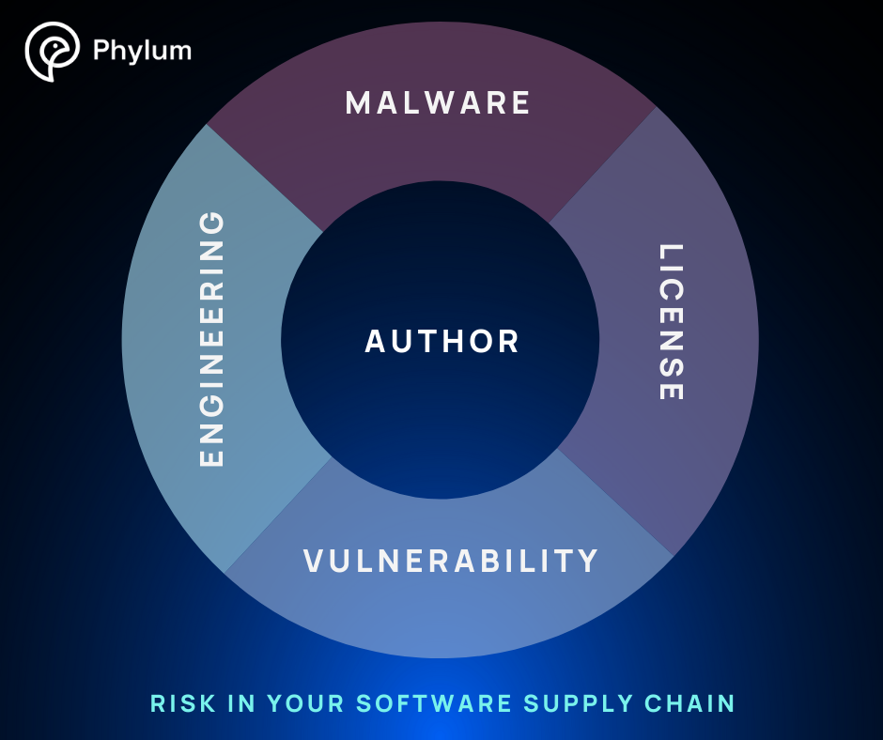
Who We Are
Notes:
First is
Malware - Is this package malicious? Is the intent to execute the software producer's will over the software consumer?
Engineering – Is this package poorly engineered? Would a senior engineer tell a junior engineer during code review to go fix stuff?
Vulnerability - Are the known vulnerabilities associated with this package? This is the domain of all Software Composition Analysis (SCA) tools.
License – Are there any legal risks for commercial enterprises associated with this package?
When these risks are aggregated, these inform an overall picture of a fifth domain of risk, namely Author risk – how trustworthy is the purported author of this package?
So five risk domains: four whats and a who.
Now, the scope of this problem is immense. And Phylum’s solution is our automated platform that monitors seven different open-source ecosystems:

Slide 6
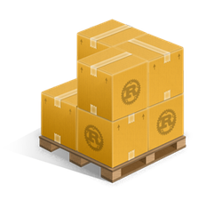
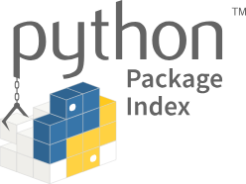
Who We Are
Notes:
npm for JavaScript
PyPI for Python
Maven Central for Java
crates.io for Rust
rubygems for Ruby
NuGet for C# and
golang for Go
Anytime a new package is published to one of these, Phylum downloads it and analyzes it. Within minutes of publication, our customers have a detailed report of all our findings across the five domains of risk. We also integrate with various CI/CD platforms so that developers can immediately know if any package or dependency has problems that they should be aware of.
And so, last year

Slide 7
June 2023
Malware and Malicious Code in the Open-Source Software Supply Chain
Notes:
I had the privilege of speaking here at Bsides SA, and I gave a broad survey of the attacks that the Phylum research team had uncovered in 2023 using Phylum’s automated platform. There I gave real-world examples from npm and PyPI of

Slide 8
June 2023
Malware and Malicious Code in the Open-Source Software Supply Chain
Spammers
Scammers
Credential stealers
Obfuscated code
Typosquatters
Combosquatters
Automated respawning malware
Notes:
Spammers
Scammers
Credential Stealers
Obfuscated code
Typosquatters
Combosquatters
Automated respawning malware on GitHub
The following week, our platform hit on an unusual package in npm:

Slide 9
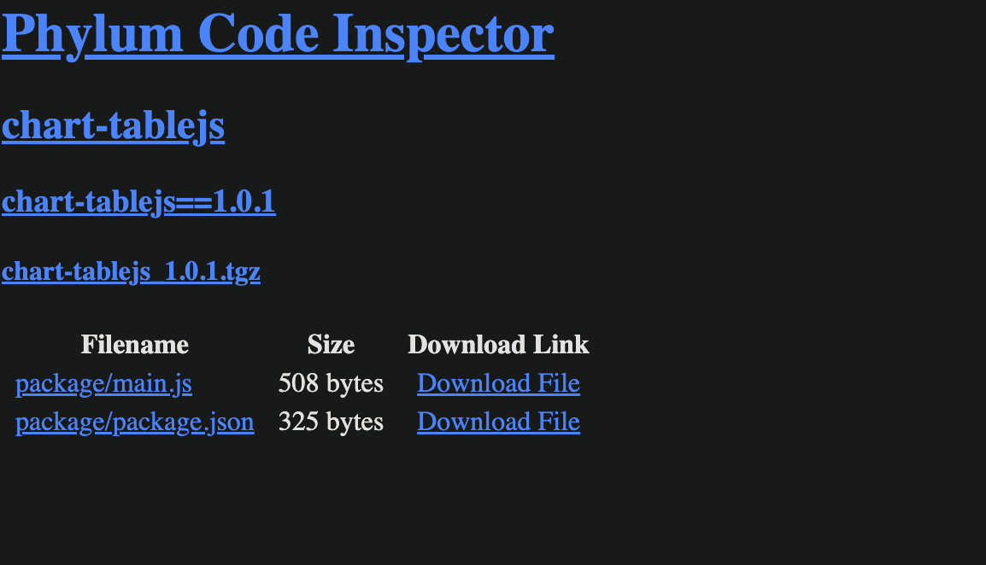
June 2023
Notes:
chart-tablejs, a simple package with two small files - not even 1KB of code. (Note that this is an example of a combosquat. There is another (albeit unpopular) npm package named chart-table. Combining that name with js for JavaScript gives this a plausible looking name for an unsuspecting developer.)
We start with the package's metadata file, package.json

Slide 10
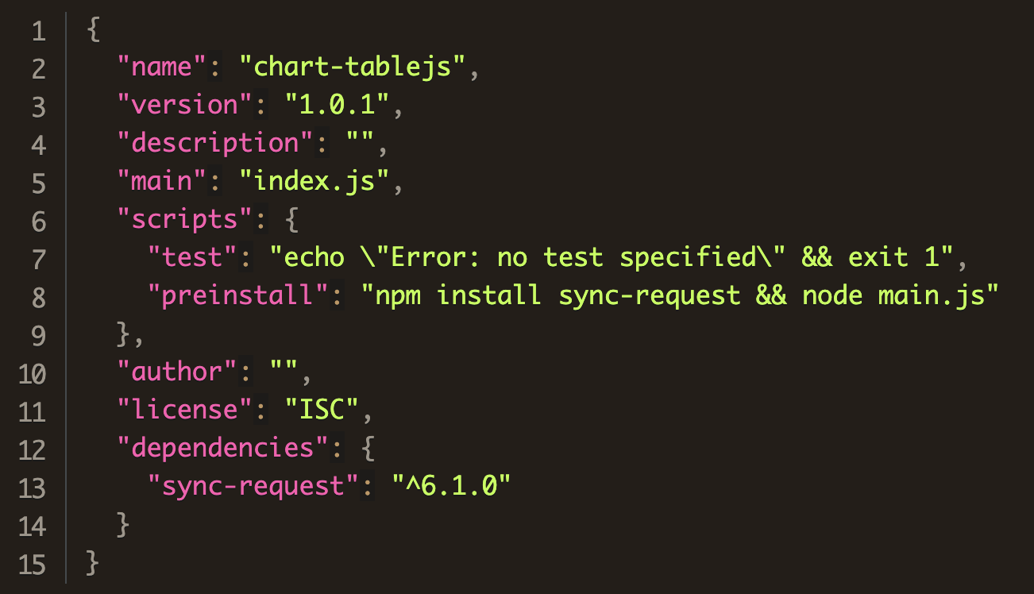
June 2023
Notes:
And this one is fairly innocuous, not much going on here...
except for the unusual preinstall hook that executes as soon as a developer executes npm install

Slide 11
June 2023
Notes:
in npm, preinstall hooks execute immediately whenever a developer installs a package.
So, this hook immediately installs the sync-request dependency and then executes main.js.
So, what do we find in main.js?

Slide 12
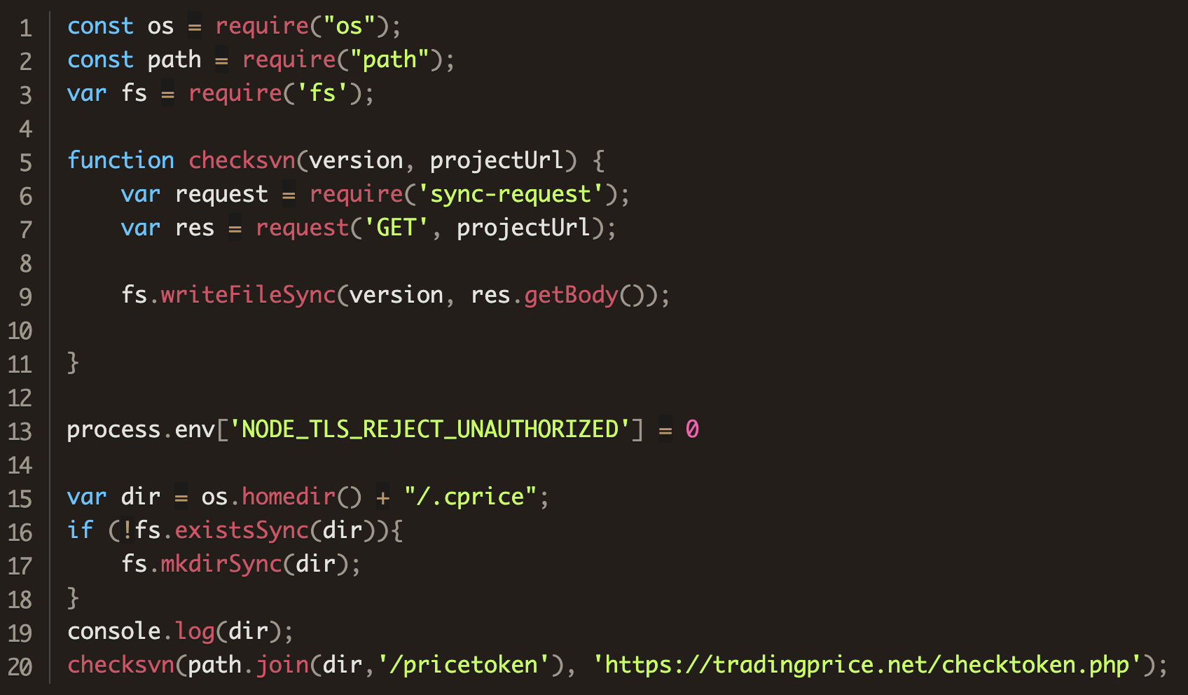
June 2023
Notes:
Not a lot. Just 20 lines of code.
First,

Slide 13
June 2023
Notes:
it turns off TLS certificate validation which simply bypasses any certificate checks
then

Slide 14
June 2023
Notes:
it creates a hidden directory named cprice in the user’s home directory. After...

Slide 15
June 2023
Notes:
...writing that directory name to the console, it calls the bespoke checksvn function which sends a GET request to the URL listed and writes the response to a new file named pricetoken in the directory just created.
And that’s it. That’s the total functionality of this package.
My research team and I had a lot of unanswered questions at this point. As we kept digging through our data for answers we found another package in npm that was published five minutes after chart-tablejs:

Slide 16
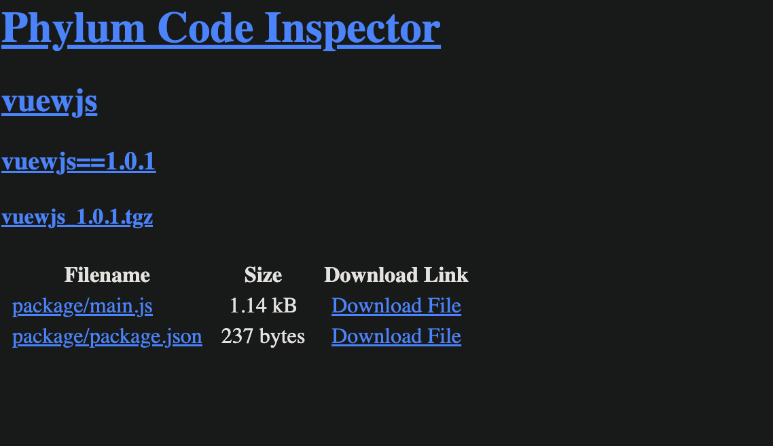
June 2023
Notes:
vuewjs, another simple package with two small files.
This time, when we look in the package.json

Slide 17
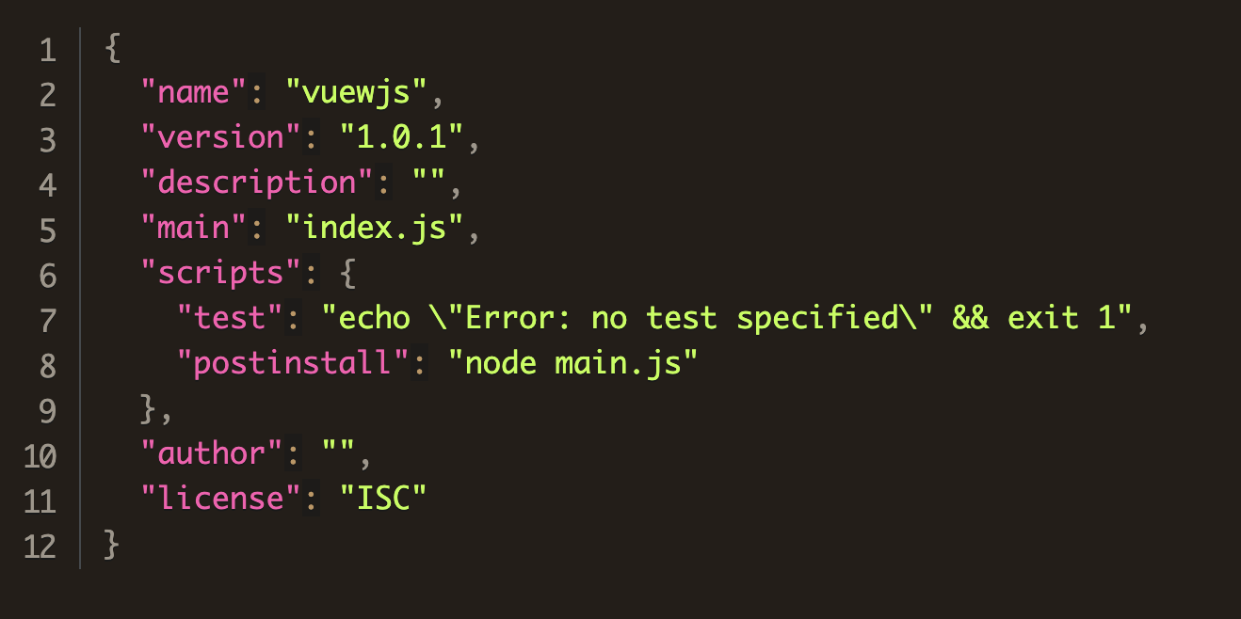
June 2023
Notes:
we find a postinstall hook that executes main.js,
and what we find there is

Slide 18
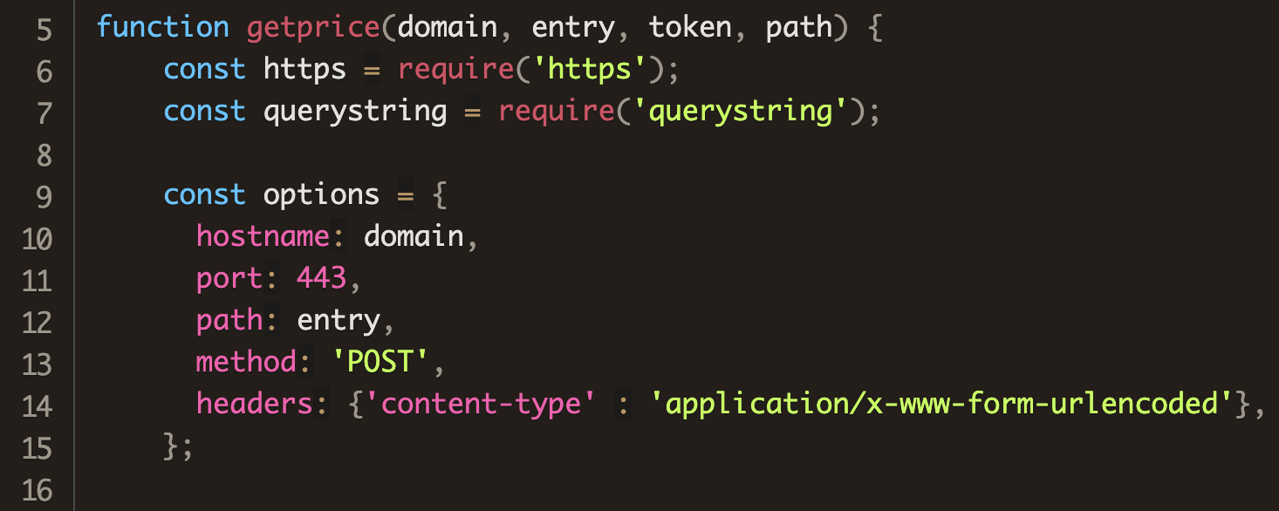
June 2023
Notes:
another bespoke function named getprice that sends a POST request on port 443, the standard TLS port to whatever parameters are passed to it

Slide 19
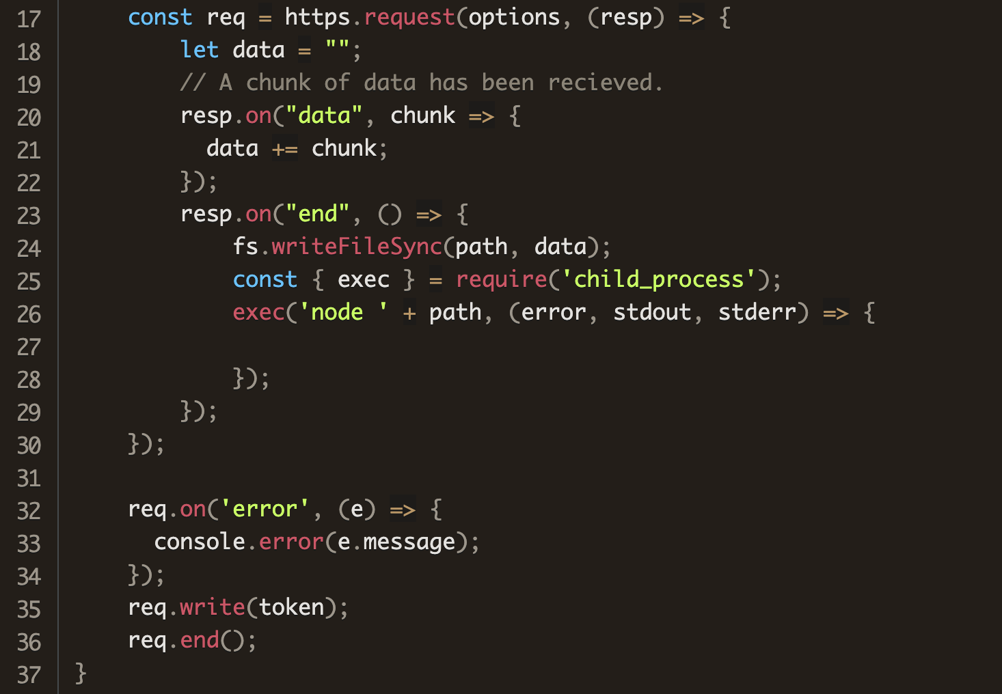
June 2023
Notes:
it then collects all the response chunks into a single buffer which it writes to the path and filename provided, and then immediately executes that file.
In this case,

Slide 20
June 2023
Notes:
after turning off TLS checks again, the vuewjs package looks for the token from that the chart-tablejs package dropped. If found, it calls getprice, the payload is retrieved and executed.
Now at this point, I’d like to note that

Slide 21
June 2023
Observations
These don’t really look like malware per se.
Notes:
These individual packages don’t really look like malware per se. Taken in isolation these packages don’t really do a whole lot. In fact, one package without the other is useless.

Slide 22
June 2023
Observations
These don’t really look like malware per se.
None of this passes the smell test.
Notes:
But, taken together, none of this passes the smell test at all. You get some random token from a server that you then authenticate with to get a payload that is downloaded and executed immediately? That is super sketchy.

Slide 23
June 2023
Observations
These don’t really look like malware per se.
None of this passes the smell test.
Traditional SCA has never, nor will ever catch this.
Notes:
And finally, no SCA tool that just scans for vulnerabilities has ever nor will ever catch anything like this at all. This code is not vulnerable. There is no CVE associated with it. If your organization only scans for vulnerabilities, then this kind of activity should give you second thoughts on your organization’s security posture.
Anyway, the biggest unanswered questions that my team and I had at this point were

Slide 24
June 2023
Observations
These don’t really look like malware per se.
None of this passes the smell test.
Traditional SCA has never, nor will ever catch this.
Questions
Who would get fooled by this?
Notes:
Who would ever download either of these? Why? It seem highly unlikely that anyone would be fooled by these packages, especially if they took even the briefest perusal of the code inside. (But Phylum is successful precisely because no one actually does look.)

Slide 25
June 2023
Observations
These don’t really look like malware per se.
None of this passes the smell test.
Traditional SCA has never, nor will ever catch this.
Questions
Who would get fooled by this?
An isolated event or are there other such packages?
Notes:
How long had this been going on? Were there other pairs of packages like this?

Slide 26
June 2023
Observations
These don’t really look like malware per se.
None of this passes the smell test.
Traditional SCA has never, nor will ever catch this.
Questions
Who would get fooled by this?
An isolated event or are there other such packages?
Who was behind all of this?
Notes:
Who was behind all of this? And what was the point?
At this point in our investigation, we had no answers to these. But, the second question was the easiest to answer.

Slide 27
June 2023
Date | GET package | POST package
26-Apr | algo-svnlook | algo-svnspawn
27-Apr | 3a-look | 3a-spawn
11-May | jsontobinary | jsontostream
11-May | json2stringify | json2double
11-May | xml2binary | xml2stream
12-May | xml2yaml | yaml2binary
15-May | iputiljs | ipmacjs
16-May | ipsecurity | ipstringfy
17-May | next2ejs | vue2ejs
12-Jun | jpeg-metadata | ttf-metadata
13-Jun | elliptic-helper | elliptic-parser
13-Jun | tslib-react | tslib-util
Notes:
Now that we knew what we were looking for, we found a dozen pairs of packages going back about six weeks prior.
The first two pairs appeared to be test packages, but the flurry of activity in May seemed to be indicative of a concerted campaign.
With each new pair of packages, the URLs, directory and file names would change slightly, sometimes reusing previous identifiers.
Though the package names varied across a wide range of topics, the identifiers in the code all revolved around a crypto theme, as we saw in the previous example.
As we studied the packages’ evolution, there also appeared to be incremental improvement such as Increased error checks.

Slide 28
June 2023
Date | GET package | POST package
15-Jun | audit-ejs | audit-vue
15-Jun | chart-vue | vue-gws
19-Jun | price-fetch | price-record
19-Jun | ejs-audit | vue-audit
20-Jun | cache-vue | cache-react
20-Jun | btc-web3 | other-web3
21-Jun | assets-graph | assets-table
21-Jun | sync-http-api | sync-https-api
22-Jun | couchcache-audit | snykaudit-helper
30-Jun | js-cookie-parser | snykaudit-helper
4-Jul | binance-prices | coingecko-price
5-Jul | eth-api-node | kucoin-prices
11-Jul | btc-api-node | kraken-prices
Notes:
Going forward from our initial find, we were able to track new pairs of packages fairly quickly, but getting the payload proved elusive. The server waiting for the POST request was never up long enough for us to get the payload.
Moreover, each new pair of packages were published under a new npm username and email address, which looked like throw away accounts.
And then, after July 11th, the packages just stopped. And we weren’t any closer to understanding what was going on.
On July 17, all of the packages that were still active on npm were taken down as security holding packages.
The next day,

Slide 29
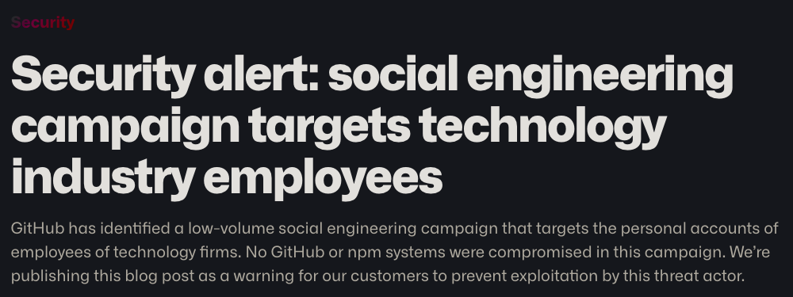
18 July - GitHub Security Alert
https://github.blog/2023-07-18-security-alert-social-engineering-campaign-targets-technology-industry-employees/
Notes:
The VP of security operations for GitHub (npm’s parent company) posted a security alert.
A social engineering campaign targeting the personal accounts of employees technology firms.

Slide 30
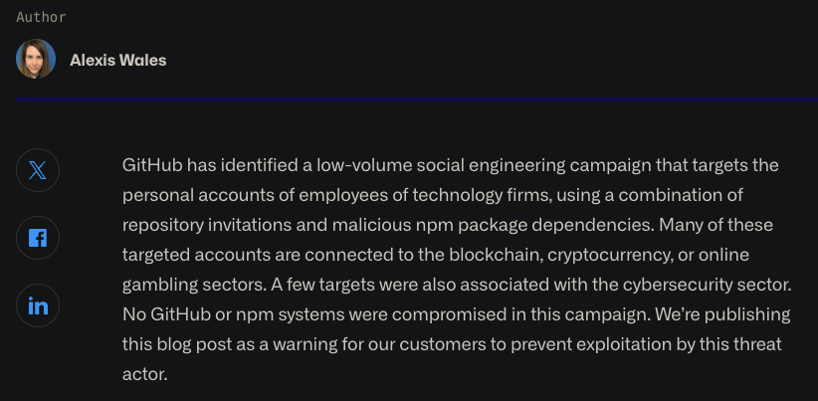
18 July - GitHub Security Alert
https://github.blog/2023-07-18-security-alert-social-engineering-campaign-targets-technology-industry-employees/
Notes:
Many of the targeted accounts were connect to blockchain, cryptocurrency, or gambling sectors and some were in cybersecurity. And because GitHub has all of the registration data for every GitHub user, they were able to attribute this activity to

Slide 31
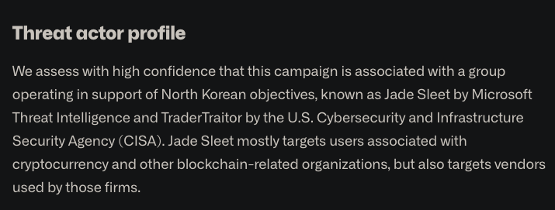
18 July - GitHub Security Alert 🇰🇵
https://github.blog/2023-07-18-security-alert-social-engineering-campaign-targets-technology-industry-employees/
Notes:
North Korea. Jade Sleet to be specific. So this explained why these packages would get installed in the first place. A Jade Sleet actor would target a developer, win their confidence and entice them to install the packages
Attack chain
The attack chain operates as follows:
Jade Sleet impersonates a developer or recruiter by creating one or more fake persona accounts on GitHub and other social media providers. Thus far, we have identified fake personas that operated on LinkedIn, Slack, and Telegram. In some cases these are fake personas; in other cases, they use legitimate accounts that have been taken over by Jade Sleet. The actor may initiate contact on one platform and then attempt to move the conversation to another platform.
After establishing contact with a target, the threat actor invites the target to collaborate on a GitHub repository and convinces the target to clone and execute its contents. The GitHub repository may be public or private. The GitHub repository contains software that includes malicious npm dependencies. Some software themes used by the threat actor include media players and cryptocurrency trading tools.
The malicious npm packages act as first-stage malware that downloads and executes second-stage malware on the victim’s machine. Domains used for the second-stage download are listed below.

Slide 32
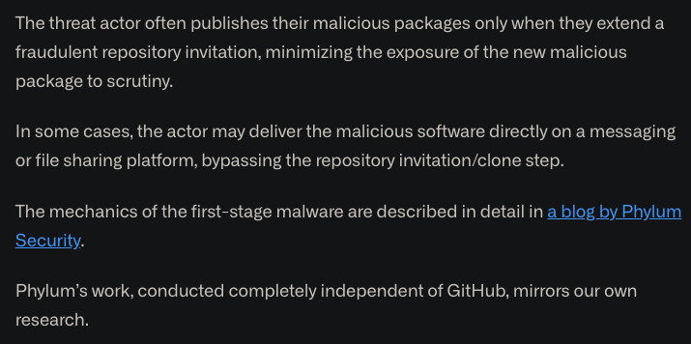
18 July - GitHub Security Alert 🇰🇵
https://github.blog/2023-07-18-security-alert-social-engineering-campaign-targets-technology-industry-employees/
Notes:
And GitHub gave Phylum a shout-out as well.
We had always suspected that nation-state actors were active in open-source, and it was only going to be a matter of time before we caught them.
As far as we know, this is the first discovery of a nation-state actor staging a campaign in open-source repositories.

Slide 33
A Quiet Place
Notes:
After that blog post, we began coordinating with the GitHub security team, sharing possible findings, but it seemed that campaign ended after GitHub outed the attackers.
Though we continued looking for Jade Sleet for the rest of the summer and the beginning of the fall of 2023, they remained elusive.
Until around Halloween

Slide 34
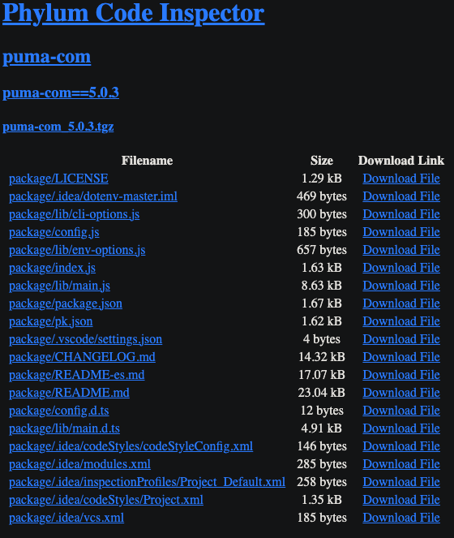
Oct/Nov 2023
Notes:
Our automated platform alerted us to the puma-com package on npm.
This package was nowhere near as sparse as the ones from the spring campaign.
Looking in the package.json file, we found

Slide 35
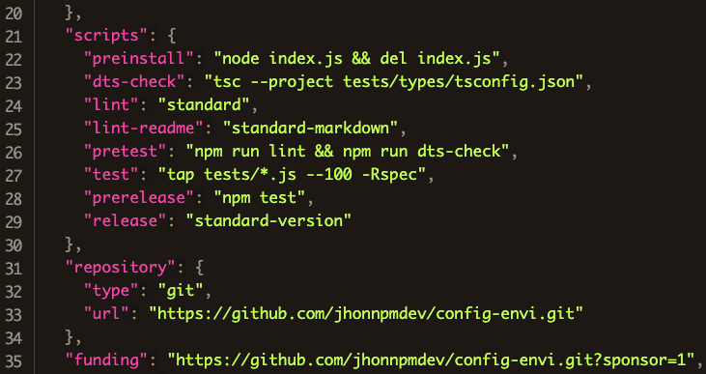
Oct/Nov 2023
Notes:
an unusual preinstall script again.
This time, index.js will run and then immediately be deleted.
Inside index.js we find

Slide 36
Oct/Nov 2023
Notes:
After some innocuous standard import statements, it declares two variables, data and psdata.
That’s hard to read, so I’ll beautify that in a moment. But looking at the rest of index.js we see

Slide 37
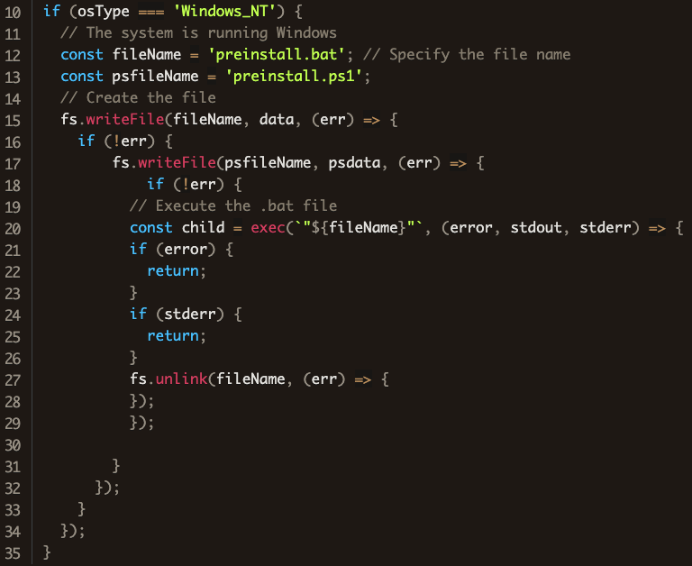
Oct/Nov 2023
Notes:
It checks the operating system of the host to see if it is Windows.
If so, it write the contents of the data variable to a file named preinstall.bat and the psdata variable to a file named preinstall.ps1
If those writes are successful,

Slide 38
Oct/Nov 2023
Notes:
it then executes preinstall.bat which it will deleted, that is unlinked, upon success.
So now we need to see what was in those variables

Slide 39
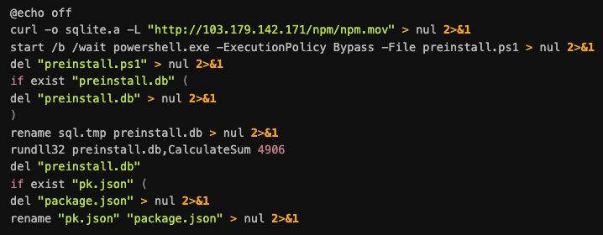
Oct/Nov 2023
Notes:
Here is a pretty printed version of preinstall.bat
First,

Slide 40
Oct/Nov 2023
Notes:
note that preinstall.bat is doing its best to suppress output (echo off, redirecting command outputs to null)
Next,

Slide 41
Oct/Nov 2023
Notes:
it uses curl to grab a file from a HTTP server at a hardcoded IP address and writes the output to a file called sqlite.a
If you try to inspect this file, you wouldn’t find anything except a blob of high entropy garbage, which is usually indicative of the presence of encryption.
More on that in a moment.
Next,

Slide 42
Oct/Nov 2023
Notes:
it launches powershell on the preinstall.ps1 file.
Note that the –ExecutionPolicy bypass runs powershell without anything blocking it and suppressing all warnings
The powershell script pretty-printed looks like

Slide 43
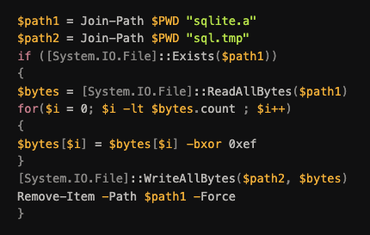
Oct/Nov 2023
Notes:
this. And, this simple script is going to take the sqlite.a

Slide 44
Oct/Nov 2023
Notes:
and decrypt it with a single byte key 0xef and write the output to sql.tmp. Now, if you inspected this file, you would find a Windows PE file.
Once done, we delete sqlite.a and return to preinstall.bat.
Now,

Slide 45
Oct/Nov 2023
Notes:
of the rest of preinstall.bat is just covering its tracks, starting with deleting the powershell script that we just used.
Next,

Slide 46
Oct/Nov 2023
Notes:
It takes our newly decrypted file, renames it to preinstall.db
and then it calls rundll32 to execute an exported function called CalculateSum with the mysterious parameter 4906
once that does whatever it does, we delete the decrypted file.
Finally,

Slide 47
Oct/Nov 2023
Notes:
It replaces our original package.json with some file called pk.json.
Where did that come from? Well,

Slide 48
Oct/Nov 2023
Notes:
if we look back in our original package, we see that pk.json shipped with our package, and is just slightly smaller than our original package.json
And comparing the difference between our original package.json and the one that this script overwrites, we see that

Slide 49
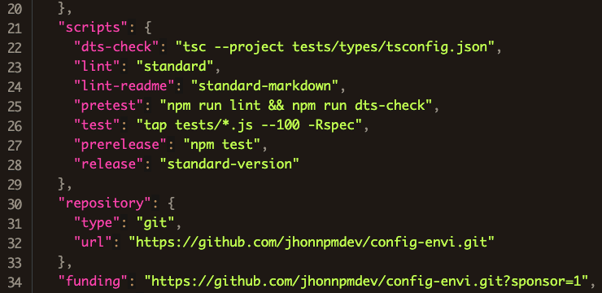
Oct/Nov 2023
Notes:
the call to the preinstall script is gone. Moreover, the index.js that orchestrated all of this is gone.
The only thing that would be on the host system is whatever the mysterious CalculateSum function did which we did not fully understand at this point
Still, we felt like this level of sophistication meant that we were back on the trail of Jade Sleet and

Slide 50
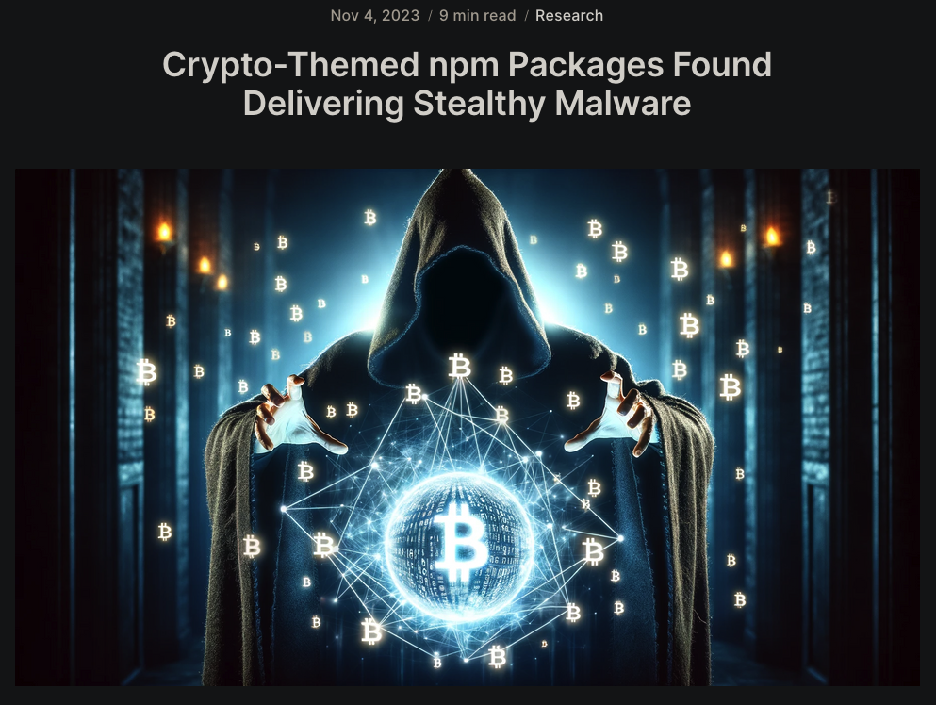
Oct/Nov 2023
Notes:
we published our findings on our blog along with four other similar packages while we were looking for other packages and trying to reverse engineer decrypted DLL file.
We did find eight other packages with this same behavior going back to Sept 14 – all of them had crypto-themed names, and nearly everyone had the same subtle changes to identifiers, published under one-time burner accounts on npm.
Interestingly, the number passed to CalculateSum function increased as time went on, and we speculated that is was used to track individual targets.
The hardcoded server IP changed occasionally along with other things like the decryption key, and we tracked these packages throughout November
In early December, the Chinese Threat Intelligence Center QiAnXin reported

Slide 51
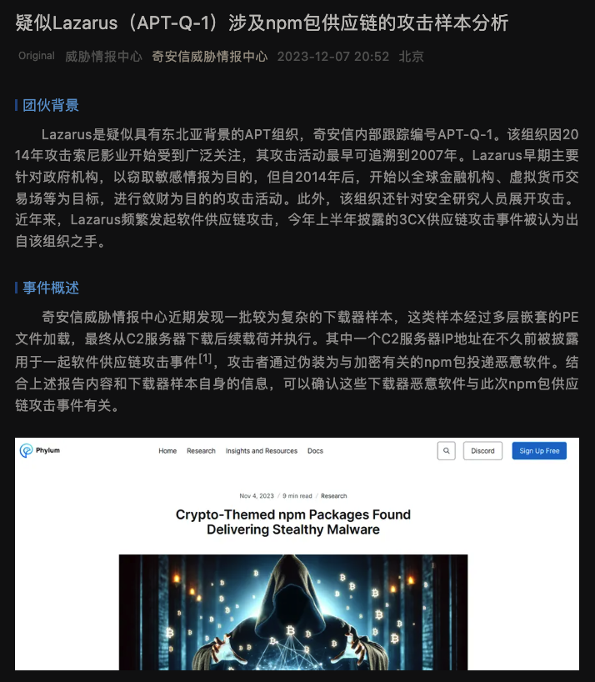
Dec 2023 🇰🇵
https://mp.weixin.qq.com/s/f5YE12w3x3wad5EO0EB53Q
Notes:
That the malware was tied to the Lazarus Group, the North Korean hacker group responsible for the Sony Pictures hack in 2014.
The google translation to English of this writeup shows much of our work, along with a lot of detailed analysis from their own reverse engineering. Later in the writeup,

Slide 52
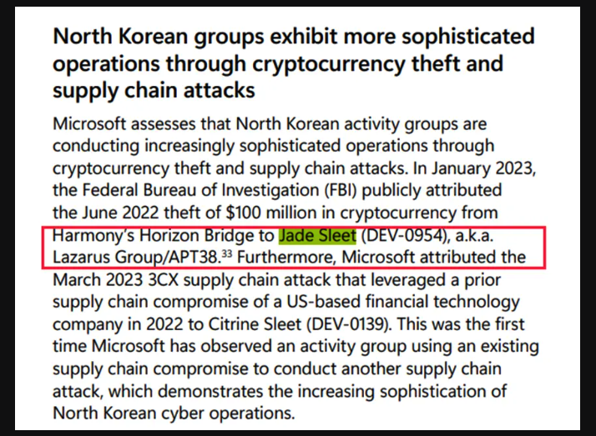
Dec 2023 🇰🇵
https://mp.weixin.qq.com/s/f5YE12w3x3wad5EO0EB53Q
Notes:
divulge the motive behind these attacks – to steal cryptocurrency. So, now we have our elusive motive. Theft.
two weeks later,

Slide 53
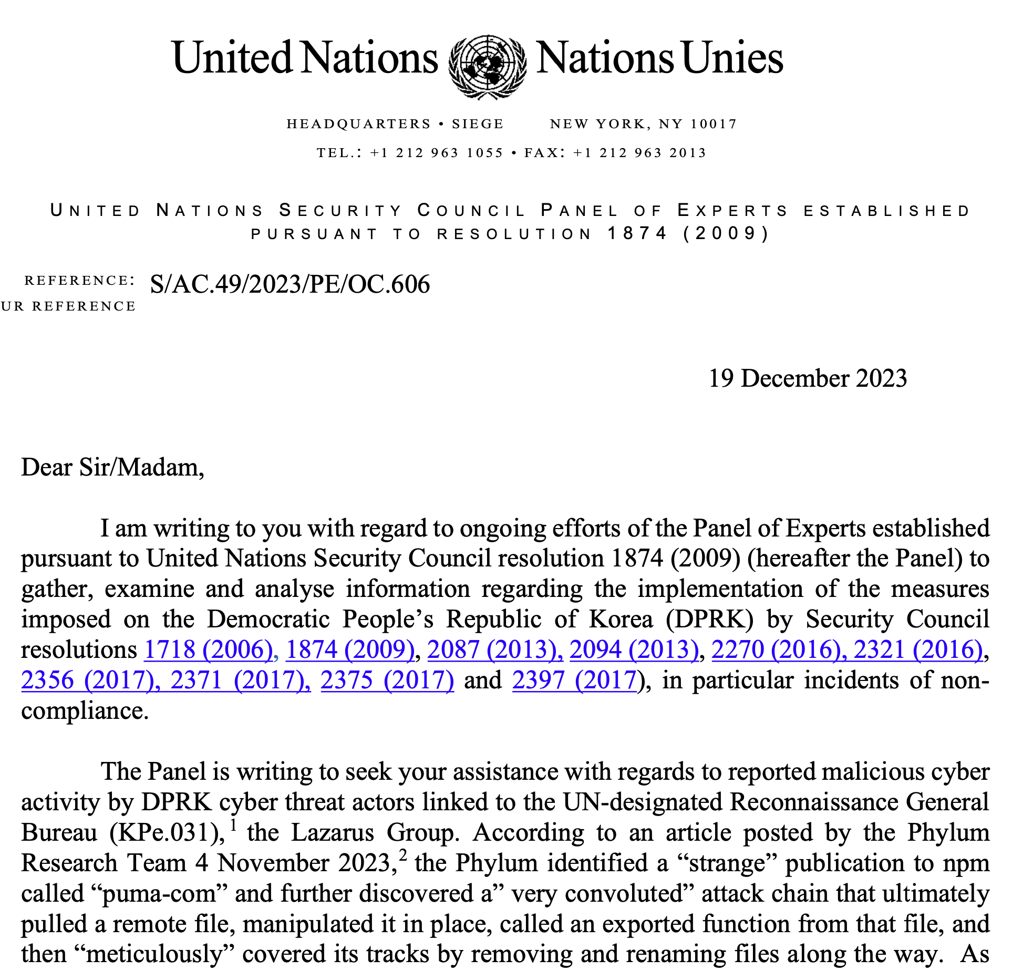
Dec 2023 🇰🇵
Notes:
We got a letter from a UN Security Council Panel of Experts asking us for more information for their semi-annual report
Our contribution to that report led them to conclude that

Slide 54
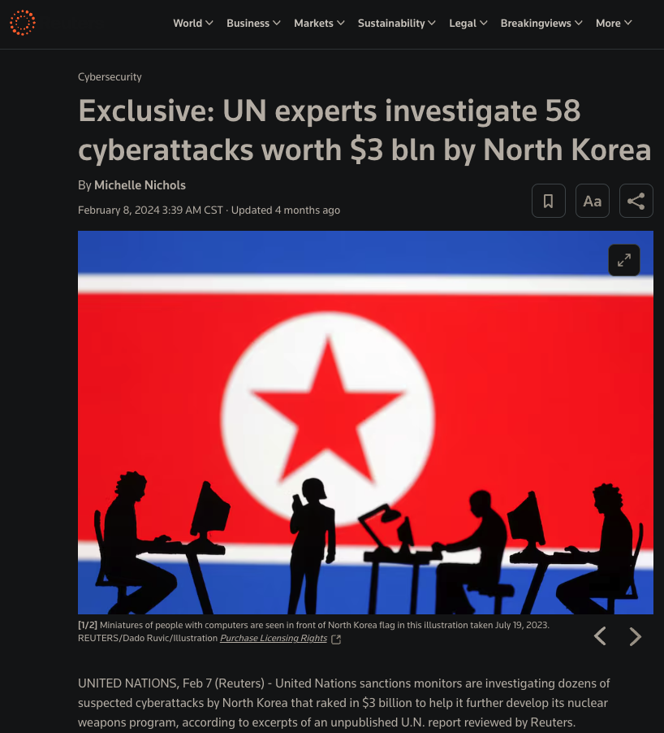
Feb 2024 🇰🇵
Notes:
North Korea has stolen approximately $3B worth of cryptocurrency that they launder to pay for their weapons program in circumvention of almost a dozen UN resolutions.
Our research team found almost three dozen packages from this campaign through early February of this year. And the actors we getting really good at covering their tracks. One particular package that we have was up on npm for only 90 seconds before the actors unpublished it.
Later that month,

Slide 55
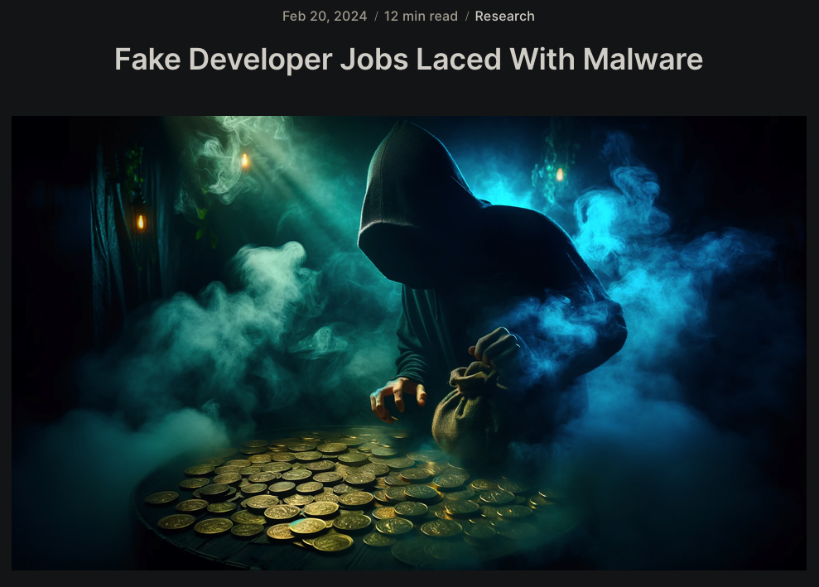
Feb 2024 🇰🇵
Notes:
our research team began tracking new npm packages associated with a social engineering campaign targeting developers with job offers.
The interviewer will happily meet you online, if you will but download this repo for a quick coding exercise…

Slide 56
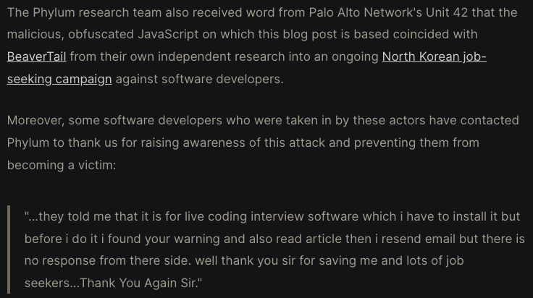
Feb 2024 🇰🇵
Notes:
This time, Palo Alto’s Network Unit 42 confirmed our suspicions that this was again the North Koreans.
A few developers who were taken in by this contacted us. Not all of them were as fortunate as this guy.
Well, I’m out of time. What are the takeaways here?

Slide 57
Conclusion
Understand the threats that are attacking open-source software
These kinds of attacks are low-risk/high-reward for the attackers
These Nation-State actors are sophisticated and well-resourced
The software developer, not the software, is the target
Notes:
Understand the threats that are attacking open-source software
These kinds of attacks are low-risk/high-reward for the attackers
These Nation-State actors are sophisticated and well-resourced
The software developer, not the software, is the target

Slide 58
Conclusion
Understand the threats that are attacking open-source software
These kinds of attacks are low-risk/high-reward for the attackers
These Nation-State actors are sophisticated and well-resourced
The software developer, not the software, is the target
Traditional SCA solutions are insufficient – of the malware we reported in Q1 2024
82% were never reported as a GitHub Malware Advisory
0% had a CVE associated with them
100% did something bad to the victim
Notes:
Traditional SCA solutions are insufficient – of the malware we reported in Q1 2024
82% were never reported as a GitHub Malware Advisory
0% had a CVE associated with them
100% did something bad to the victim

Slide 59
Conclusion
Understand the threats that are attacking open-source software
These kinds of attacks are low-risk/high-reward for the attackers
These Nation-State actors are sophisticated and well-resourced
The software developer, not the software, is the target
Traditional SCA solutions are insufficient – of the malware we reported in Q1 2024
82% were never reported as a GitHub Malware Advisory
0% had a CVE associated with them
100% did something bad to the victim
You need a defense-in-depth approach
Follow our blog for our latest research findings: blog.phylum.io/research
Notes:
You need a defense-in-depth approach
Follow our blog for our latest research findings: blog.phylum.io/research

Slide 60
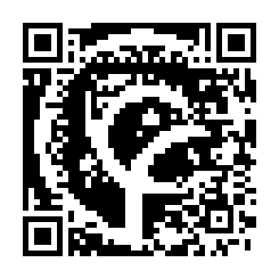
Questions?
Ross Bryant, Ph.D.
ross@phylum.io
Notes:
Thank you for your time. This is a link to our research blog where you can all of the details for the attacks and others.
I’ll take any questions.

